Slide 1


The 20th International Conference on Information Security Practice and Experience
ISPEC 2025
November 7-9th 2025
Chengdu, China
G-FLEX: A Graph-based and Fine-Tuned Transformer Framework with Explainable AI for Fileless Malware Dectection
Bao Pham-Thai, Nghi Hoang Khoa, Ngo Duc Hoang Son, Khanh Ho-Vi, Phan The Duy
Information Security Laboratory
University of Information Technology, VNU-HCM, Vietnam
Presented by Ngo Duc Hoang Son

Slide 2
Outline
Introduction
Overview of G-FLEX
Methodology
Experiments & Results
Conclusion & Future Work

Slide 3
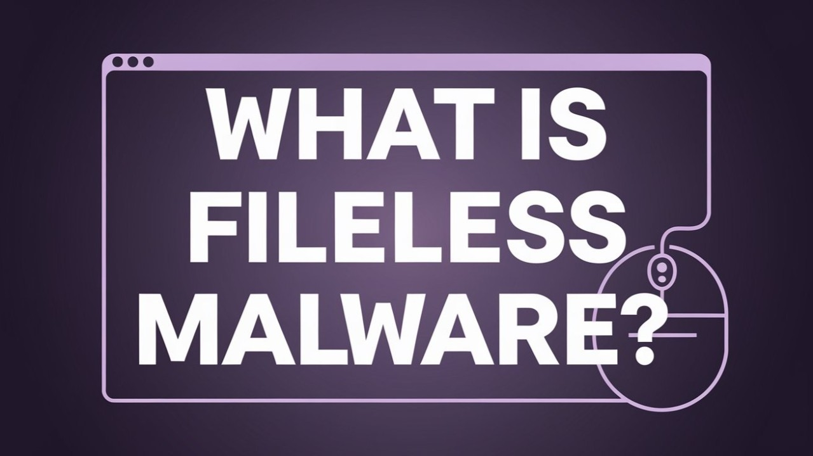
What is Fileless Malware?
No files: Runs in memory using system tools.
Stealthy: Hard to detect, leaves no trace on disk.

Slide 4


The Fileless Malware Challenge
A rising cybersecurity threat due to stealthy and memory-resident behavior.
Exploits legitimate Windows tools: PowerShell, VBA, and JavaScript.
Context: 58% rise in APT attacks (2024) targeting critical sectors. Detection requires deep analysis of in-memory execution and scripts.

Slide 5
Limitations of Existing Methods
Over-reliance on a single analysis approach (e.g., source code or AST), limiting feature diversity and depth.
Source code analysis may miss execution dynamics; AST analysis may lack contextual depth.
Current AI models often lack interpretability (black-box problem), hindering analyst trust and threat verification.

Slide 6
The G-FLEX Proposal
G-FLEX: A novel framework integrating graph representations, fine-tuned transformers, and Explainable AI (XAI).
Objective: Achieve >99% detection accuracy on both standard and obfuscated malware, while providing transparency and actionable insights.

Slide 7
Overview of G-FLEX

Slide 8
Code Transformation
Abstract Syntax Trees (ASTs): Generated from source code to capture structural information, facilitating statistical analysis and feature extraction.
Control Flow Graphs (CFGs): Source code is transformed into CFGs to explicitly model execution flow and functional relationships.
Note: CFG representation is crucial for robustly handling code obfuscation techniques.

Slide 9
Multi-dimensional Feature Extraction
From Source Code & AST: Features include shellcode presence, Entropy analysis (detects obfuscation), and URL/IP detection (C2 indicators).
From CFG: Graph embeddings are generated using GraphCodeBERT to capture structural and contextual properties (resulting in a 768-dim vector).

Slide 10
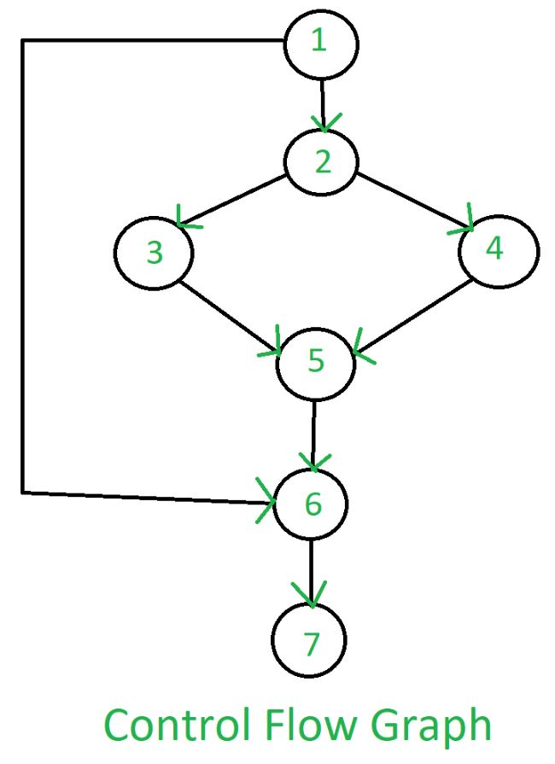
Role of CFGs
CFG models execution flow and function relations
Adds semantic depth beyond AST alone
Reveals hidden intent in obfuscated PowerShell code

Slide 11
Fine-tuning
Fine-Tuned LMs: Utilizes state-of-the-art Language Models (BERT, Electra, CodeBERT) and Hierarchical Transformers to model long-range and multi-level dependencies.
Classification: A Random Forest (RF) classifier is trained on the aggregated features for improved accuracy and reliability.

Slide 12
Language Model Fine-Tuning
Preprocessing: Normalize code (lowercase, remove comments) to reduce noise.
Chunking: Split into 512-token chunks with 50-token overlap to preserve context.
Language Models:
BERT: Strong bidirectional context understanding.
Electra: Efficient pre-training.
CodeBERT: Specialized for code semantics.
Hierarchical Transformers: Aggregate chunk embeddings via Bi-LSTM for long-sequence representation.

Slide 13
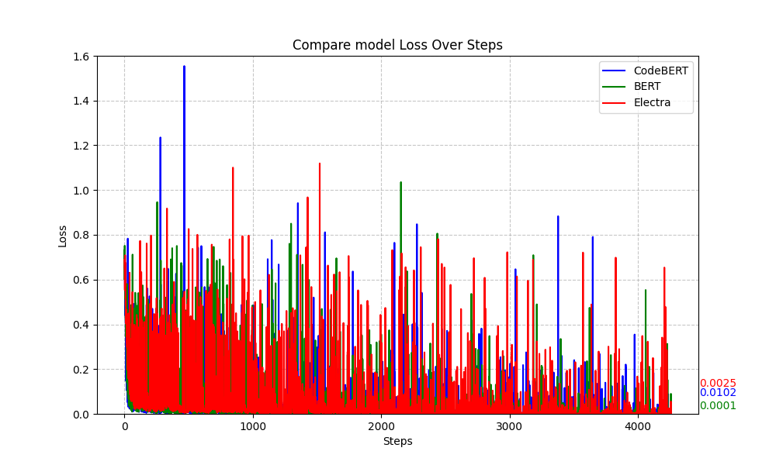
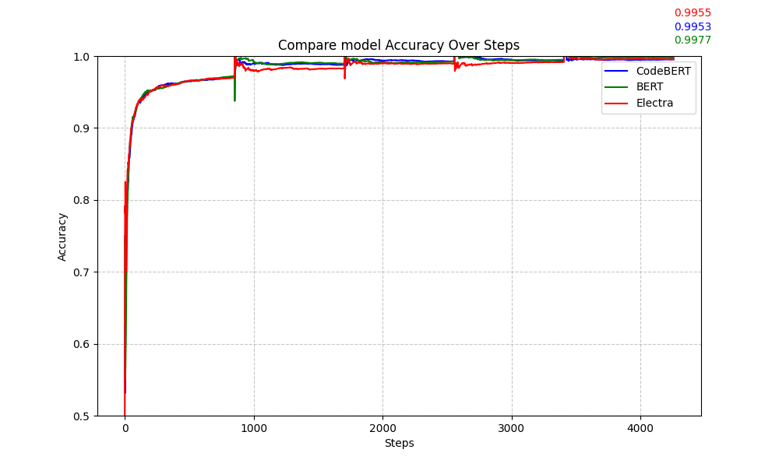
Language Model Fine-Tuning
Fine-Tuning Results
Accuracy > 99.5% for CodeBERT, BERT, Electra
Loss drops quickly and stabilizes
Fine-tuning proves highly effective

Slide 14
Explainable AI
Enhance Trust: Provide transparency into the model's decision-making, essential as AI moves from support tool to decision system.
Support Analysts: Deliver actionable insights, helping analysts verify that the model's reasoning aligns with known attack behaviors
SHAP Technique: The study employs SHAP (SHapley Additive exPlanations) to quantify the importance and contribution of each feature to the model's output.

Slide 15
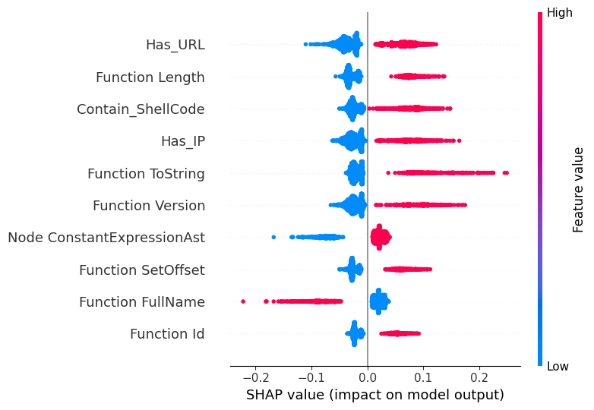
Explainable AI

Slide 16
Experiment data
Dataset ^{[1]} includes: 4.316 benign scripts, 4.202 malware scripts, and 4.202 obfuscated malware scripts
Objective: To support the rigorous evaluation of detection models under realistic conditions.
[1] https://github.com/das-lab/mpsd

Slide 17
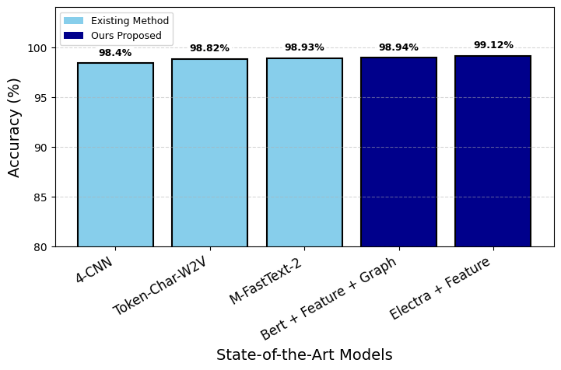
Experiment results
Pure Malware Scenario: Electra + Features (Source/AST) achieved the best accuracy (0.9912).

Slide 18
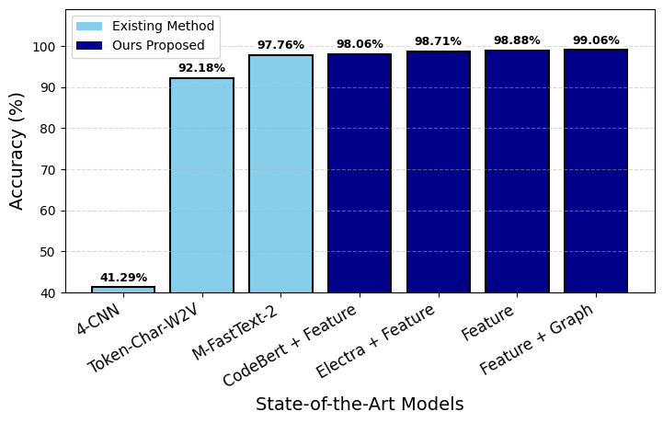
Experiment results
Mixed Malware (w/ Obfuscation): CFG + Features (Source/AST) performed best (0.9906).

Slide 19
Conclusion
G-FLEX is a highly effective framework combining graph-based representations (AST/CFG) with fine-tuned LMs.
The proposed methodology significantly outperforms existing AST-based and source-code-based approaches.
The integration of XAI (SHAP) provides crucial interpretability and actionable insights, enabling security experts to understand, validate, and trust the system's decisions.
Notes:
To conclude, we have demonstrated that G-FLEX is a highly effective framework.
By combining graph-based representations with fine-tuned language models, it significantly outperforms existing approaches.
Most importantly, our integration of XAI with SHAP provides critical interpretability, allowing analysts to understand, validate, and trust the system's decisions

Slide 20
Limitations and Future Work
Limitations: The dataset is relatively small and limited to PowerShell, which may constrain model generalizability.
Future Work:
Focus on refining graph representations to better capture advanced APT patterns.
Explore alternative graph structures for richer information encoding.
Investigate additional XAI methods to further enrich the understanding of model behavior.

Slide 21




Thank you!
sonndh@gm.uit.edu.vn
Information Security Laboratory
University of Information Technology, VNU-HCM, Vietnam

